Slide 1
Chapter 1: Introduction
(SHAKILA ZAMAN)
Reff: NAT, BIS

Slide 2
Objectives
To provide a grand tour of the major operating systems components
To provide coverage of basic computer system organization

Slide 3
What is an Operating System?
A program that acts as an intermediary between a user of a computer and the computer hardware.
Operating system goals:
  Execute user programs and make solving user problems easier.
  Make the computer system convenient to use.
Use the computer hardware in an efficient manner.

Slide 4
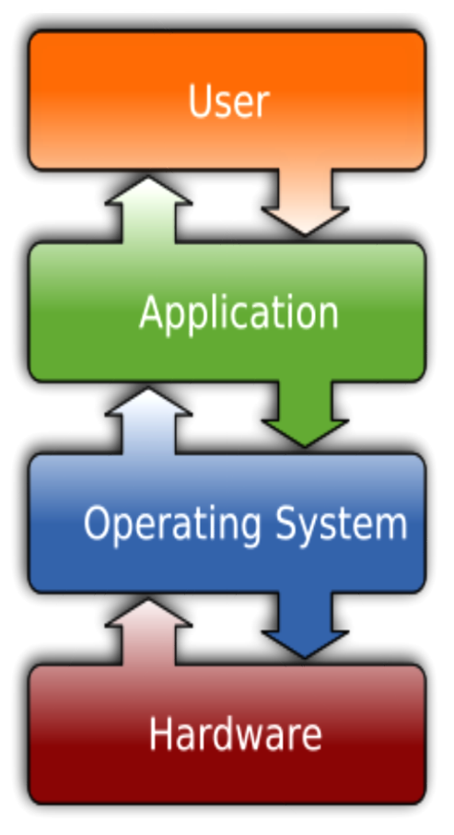
Software
  The two most common types of software are :
    System software
    Application software.
  What is System Software?
  System Software refers to the operating system and all utility programs that manage computer resources at a low level. Systems software includes compilers, loaders, linkers, and debuggers.
  What is Application Software?
  Applications software comprises programs designed for an end user, such as word processors, database systems, and spreadsheet programs.

Slide 5
Computer System Structure
Computer system can be divided into four components
  Hardware – provides basic computing resources
    CPU, memory, I/O devices
  Operating system
    Controls and coordinates use of hardware among various applications and users
  Application programs – define the ways in which the system resources are used to solve the computing problems of the users
    Word processors, compilers, web browsers, database systems, video games
  Users
    People, machines, other computers

Slide 6

Four Components of a Computer System

Slide 7
Operating System Definition
OS is a resource allocator
  Manages all resources
  Decides between conflicting requests for efficient and fair resource use
OS is a control program
  Controls execution of programs to prevent errors and improper use of the computer

Slide 8
Operating System Definition (Cont.)
No universally accepted definition
“Everything a vendor ships when you order an operating system” is good approximation
  But varies wildly
“The one program running at all times on the computer” is the kernel. Everything else is either a system program (ships with the operating system) or an application program

Slide 9

Computer System Organization
Computer-system operation
  One or more CPUs, Memory, device controllers connect through a common bus which is called system bus.
Notes:
System bus= Data bus + Address bus + control bus

Slide 10
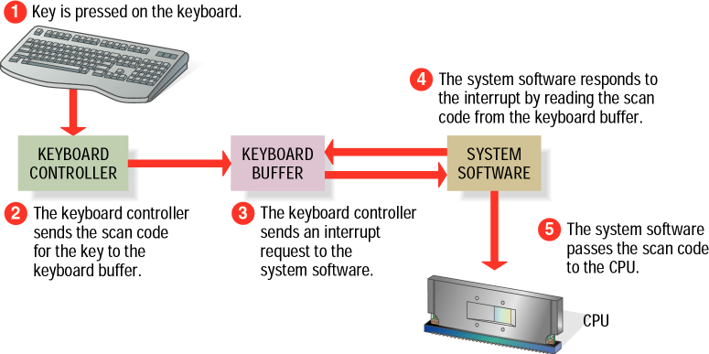
Computer-System Operation
I/O devices and the CPU can execute concurrently.
Each device controller is in charge of a particular device type.
Each device controller has a local buffer.
CPU moves data from/to main memory to/from local buffers
Device controller informs CPU that it has finished its operation by causing an interrupt.

Slide 11
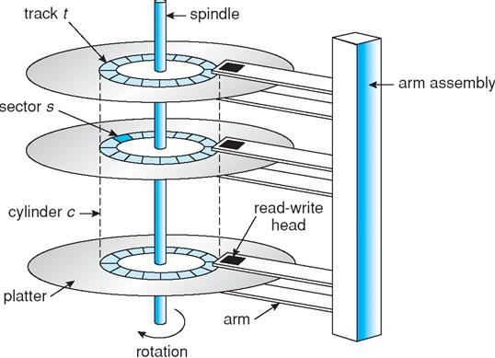
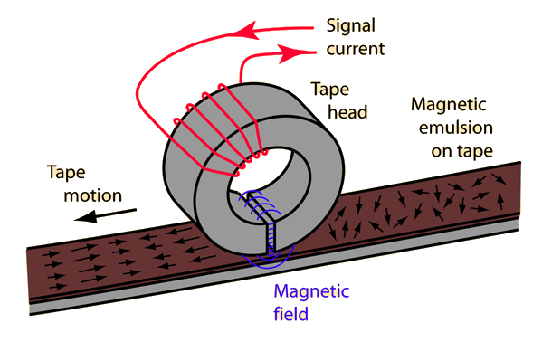
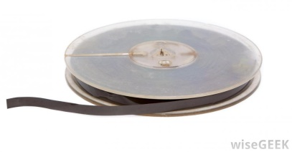
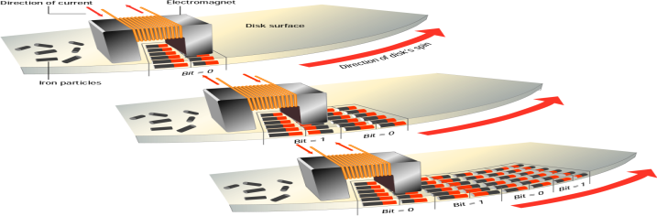
Storage Structure
Main memory – only large storage media that the CPU can access directly.
Secondary storage – extension of main memory that provides large nonvolatile storage capacity.
  Magnetic disks – rigid metal or glass platters covered with magnetic recording material
    Disk surface is logically divided into tracks, which are subdivided into sectors.
    The disk controller determines the logical interaction between the device and the computer.
  Magnetic Tapes

Slide 12
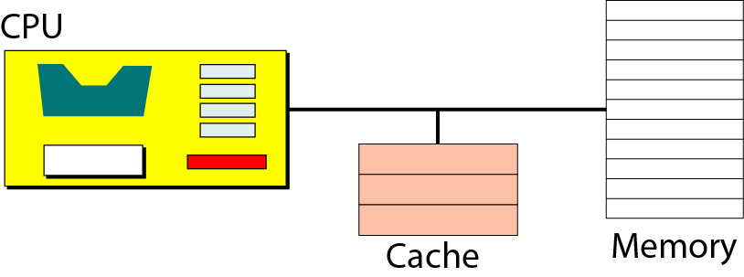
Storage Hierarchy
Storage systems organized in hierarchy.
  Speed
  Cost
  Volatility
  Size
Caching – Information in use copied from slower to faster storage temporarily

Slide 13

Storage-Device Hierarchy
Notes:
Electronic disk – flash memory (ROM)
Optical disk – CD, DVD
Magnetic disk - hard disks, floppy disks

Slide 14

Performance of Various Levels of Storage
Movement between levels of storage hierarchy can be explicit or implicit

Slide 15
Operating System Structure
Multiprogramming needed for efficiency
  Single user cannot keep CPU and I/O devices busy at all times
  Multiprogramming organizes jobs (code and data) so CPU always has one to execute
  A subset of total jobs in system is kept in memory
  One job selected and run via job scheduling
  When it has to wait (for I/O for example), OS switches to another job

Slide 16
Operating System Structure (cont)
Timesharing (multitasking) is logical extension in which CPU switches jobs so frequently that users can interact with each job while it is running, creating interactive computing
  Response time should be < 1 second
  Each user has at least one program executing in memory process
  If several jobs ready to run at the same time  CPU scheduling
  If processes don’t fit in memory, swapping moves them in and out to run
  Virtual memory allows execution of processes not completely in memory
Notes:
Multiprogramming - A computer running more than one program at a time (like running Excel and Firefox simultaneously) http://en.wikipedia.org/wiki/Multiprogramming
Multiprocessing - A computer using more than one CPU at a timehttp://en.wikipedia.org/wiki/Multiprocessing
Multitasking - Tasks sharing a common resource (like 1 CPU)http://en.wikipedia.org/wiki/Computer_multitasking#Multithreading
Thus, something like multithreading is an extension of multitasking.

Slide 17

Memory Layout for Multiprogrammed System

Slide 18
Hardware Protection
With sharing many processes could be adversely affected by a bug in one program. So, a properly designed OS must ensure that an incorrect program can not run and also can not cause other programs to execute incorrectly.
Many errors detected by hardware can be handled by OS.
Hardware generates interrupt.
Software error handled by exception or trap.

Slide 19
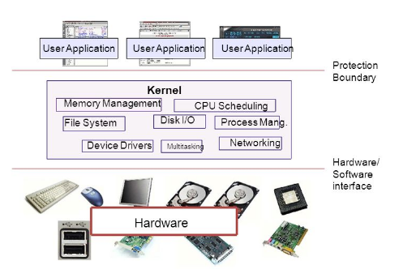
Hardware Protection
Dual-mode operation allows OS to protect itself and other system components
  User mode (1) and Monitor/System mode (0)
  Mode bit provided by hardware
    Provides ability to distinguish when system is running user code or system code
    Some instructions designated as privileged, only executable in system mode

Slide 20
Hardware Protection
At system boot time, the hardware starts in kernel mode.
The operating system is then loaded and starts user applications in user mode.
Whenever a trap or interrupt occurs, the hardware switches from user mode to kernel mode (that is, changes the state of the mode bit to 0).
Thus, whenever the operating system gains control of the computer, it is in kernel mode.
The system always switches to user mode (by setting the mode bit to 1) before passing control to a user program.

Slide 21
Hardware Protection
I/O Protection
  To prevent a user from performing illegal I/O, we define all I/O instructions to be privileged instruction.

Slide 22
Hardware Protection
Memory Protection
  A user program might overwrite instructions in the interrupt service routine. So, we must protect the interrupt vector from modification by a user program.

Slide 23
Hardware Protection
CPU Protection
  We must prevent a user program getting stuck in an infinite loop and never returning the control to the OS. To accomplish this goal, we can use a timer.

Slide 24
Related Article
introduction, 1.1, 1.2, 1.2.1, 1.2.2,1.3.1,1.3.2, 1.4, 1.5, 1.8.3

Slide 25
OS STRUCTURES
Chapter 2

Slide 26
Process Management
A process is a program in execution. It is a unit of work within the system. Program is a passive entity, process is an active entity.
Process needs resources to accomplish its task
  CPU, memory, I/O, files
  Initialization data
Process termination requires reclaim of any reusable resources
Processes maybe single-threaded or multi-threaded
  Process executes instructions sequentially, one at a time, until completion
Typically a system has many processes running concurrently on one or more CPUs
  Concurrency by multiplexing the CPUs among the processes / threads
Notes:
Concurrency will be handled by scheduling algorithm or time scheduling.

Slide 27
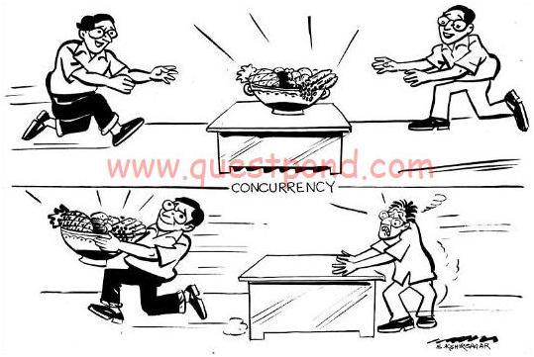
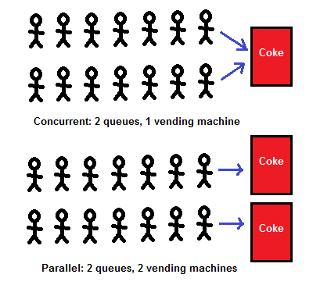
Concurrency

Slide 28
Process Management Activities
The operating system is responsible for the following activities in connection with process management:
Creating and deleting both user and system processes
Suspending and resuming processes
Providing mechanisms for process synchronization
Providing mechanisms for process communication
Providing mechanisms for deadlock handling

Slide 29
Memory Management
All data in memory before and after processing
All instructions in memory in order to execute
Memory management determines what is in memory when
  Optimizing CPU utilization.
Memory management activities
  Keeping track of which parts of memory are currently being used and by whom
  Deciding which processes (or parts thereof) and data to move into and out of memory
  Allocating and de-allocating memory space as needed

Slide 30
Storage Management
OS provides uniform, logical view of information storage
  Abstracts physical properties to logical storage unit - file
  Each medium is controlled by device (i.e., disk drive, tape drive)
    Varying properties include access speed, capacity, data-transfer rate, access method (sequential or random)
File-System management
  Files usually organized into directories
  Access control on most systems to determine who can access what
  OS activities include
    Creating and deleting files and directories
    Primitives to manipulate files and directories
    Mapping files onto secondary storage
    Backup files onto stable (non-volatile) storage media

Slide 31
Mass-Storage Management
Because main memory is too small to accommodate all data and programs, and its data is lost when power is lost, the computer system must provide secondary storage to back up main memory.
Proper management of disk storage is of central importance to a computer system.
OS activities
  Free-space management
  Storage allocation
  Disk scheduling

Slide 32
I/O Subsystem Management
One purpose of OS is to hide peculiarities of hardware devices from the user
I/O subsystem responsible for
  Memory management of I/O including buffering (storing data temporarily while it is being transferred), caching (storing parts of data in faster storage for performance), spooling (the overlapping of output of one job with input of other jobs)
  General device-driver interface
  Drivers for specific hardware devices

Slide 33
Protection and Security
Protection – refers to a mechanism for controlling the access of programs, processes or user’s to the resources defined by a computer systems.
Security – defense of the system against internal and external attacks
  Huge range, including denial-of-service, worms, viruses, identity theft, theft of service
Systems generally first distinguish among users, to determine who can do what
  User identities (user IDs, security IDs) include name and associated number, one per user
  User ID then associated with all files, processes of that user to determine access control

Slide 34
End of Lecture 1

